Slide 1

Speak Fluently & Confidently A2- Course 1

Slide 2
Session 7- Talking about Food
Part 1-: Restaurants – Part 1 ( Listening)
Part 2: What would you say in the following
situations? ( More Idioms & collocations)
Part 3: Speaking Practice
https://befluent.me/

Slide 3
Session 7- Talking about Food
Part 1-: Restaurants- Part 1
( Listening )
https://befluent.me/

Slide 4
Lesson 8: Restaurants – Making Reservations & Understanding the Menu
We’re going to eat out – that means eating at a restaurant. This will be a two-part lesson. Today you’ll learn how to make reservations, what to say when you arrive at the restaurant, and how to understand the menu.
Tomorrow you’ll learn how to make orders, interact with the waiter or waitress, pay for the food, and talk about your experience at the restaurant.
Conversation #1 – Making a Reservation
It’s a good idea to call the restaurant and make a reservation in three cases:
First, if you are going to a nice/expensive restaurant.
Second, if you are going to a restaurant that is very popular.
Third, if you are going to the restaurant with a large number of people, and you want to make sure that the restaurant has enough space for everybody.
Restaurant: Angelo’s Restaurant.
John: Hi, I’d like to make a dinner reservation for tomorrow night at 7:30. Restaurant: How many in your party?
John: Six.
Restaurant: Can I get your name and phone number?
John: My name is John Smith, and my number is 203-555-8714
Restaurant: Okay, so I have a reservation for a party of six, under the name “Smith,” tomorrow night at 7:30, is that correct?

Slide 5
John: Yes, that’s right. We’ll also need one high chair and one booster seat.
Restaurant: Not a problem. Is there anything else?
John: No, that’s it, thanks.
Restaurant: All right, Mr. Smith, we’ll see you tomorrow night at 7:30.
Conversation Vocabulary & Phrases
In general, when making a restaurant reservation, you need to give your name, phone number, and the date and time you plan to go to the restaurant.
When the person at the restaurant asks “How many in your party?” she wants to know how many people total will be coming to the restaurant.
If you have any special requests, you can make them – for example, in this conversation, Mr. Smith asks for one high chair and one booster seat. A high chair is a chair for a baby, and a booster seat is a chair for a small child.
While making the reservation, you can also ask for a table in a specific location, for example:
“Can we have a table near the window?”
“Can we have a table on the balcony?”
Conversation #2 – Arriving at the Restaurant
When you enter the restaurant, the person (usually a woman) who greets you is called the hostess. If you made a reservation before arriving, you can say to her:
“I have a 7:30 reservation for John Smith.”
If you didn’t make a reservation, you might need to wait for a table if the restaurant
is crowded (that is, if there are many people in the restaurant):
Hostess: Welcome to Angelo’s – do you have a reservation?
William: No, we don’t.

Slide 6
Hostess: It’s gonna be about a 10-minute wait. Can I get your name?
William: Johnson.
Hostess: OK, and a table for two?
William: Mmm-hmm.
Hostess: All right, you can wait right over there and I’ll let you know when your
table is ready.
Conversation Vocabulary & Phrases
In spoken English, “going to” is often pronounced “gonna,” like when the hostess
says “It’s gonna be about a 10-minute wait.”
The expression “mm-hmm” is a way to say “yes.” English has many different ways to say “yes” and “no” (click here and here for some examples).
Also, if the restaurant has a bar, the hostess may ask if you want to sit at the bar and have a drink while you wait.
If there are tables available when you enter the restaurant, then the hostess will ask you how many people:
Hostess: Good evening. How many?
William: Two.
Hostess: Right this way, please.
(right this way = come with me - you should follow the hostess to the table)
After you sit down, a person will come and ask if you want any drinks. The name of this person is the waiter (if he is a man) or waitress (if she is a woman) –
or server (which can be a man or a woman).

Slide 7
Server: Hi, my name is Sarah and I’ll be your server tonight. How are you doing?
William: Good, thanks.
Server: Here’s the menu. Can I get you anything to drink?
(notice the pronunciation of “Can I get you” – kinIgetcha)
William: Just water for now.
Server: OK, I’ll be back in a few minutes to take your order.
The menu is the list of foods that the restaurant offers, and how much they cost. We use a specific verb for the action of asking for food in a restaurant: to order.
Vocabulary Builder: Understanding the Menu
The menu will often be divided into different sections:
Appetizers or starters are small amounts of food that are eaten before the main dish.
Main dishes or entrees are the biggest and most important parts of the meal, eaten after the appetizers and before dessert. This can also be called the main course.
Specials are specific dishes that are prepared particularly for today, and are often at a reduced price.
Combos is short for combinations - two or more foods that are ordered together as a single item (for example, at McDonald’s you can order a “combo” of a hamburger, French fries, and soda for one price).
Side dishes or sides are small portions of food that can be ordered to accompany the main dishes – for example, you can order a steak with a side of mashed potatoes.
Desserts are sweet foods eaten after the main dish, like ice cream, cakes, pies, etc.
Beverages is another word for drinks. There are also cocktails, which are mixed alcoholic drinks (like margaritas, martinis, and other alcoholic drinks like tequila and rum that are mixed with fruit juices and other ingredients).

Slide 8
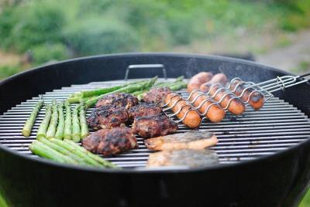
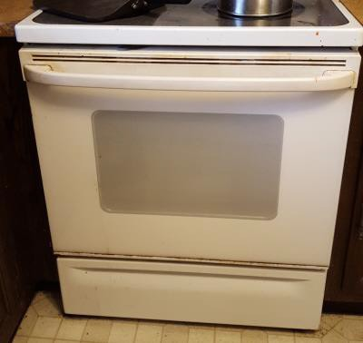
Some menus also categorize the foods by types – for example: sandwiches, soups, salads, seafood (that means animals from the ocean like fish, crab, lobster, etc.), pasta, meat, and poultry (poultry means chicken).
Now let’s learn various ways that food can be prepared.
Food can be grilled or barbecued (cooked on a grill)
Roasted or baked (cooked inside an oven)
Boiled (cooked in water)

Slide 9
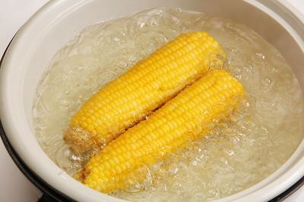
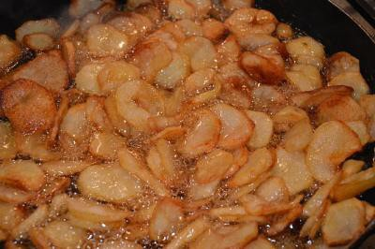
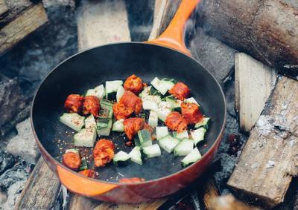
Fried (cooked in oil)
Sautéed (cooked in a very small amount of oil)
Broiled (cooked at high heat for a short time)
Marinated (soaked in liquid to give it more flavor)

Slide 10
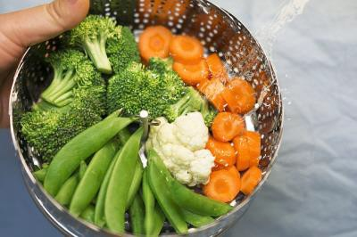
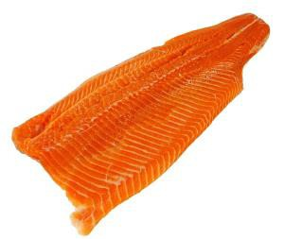
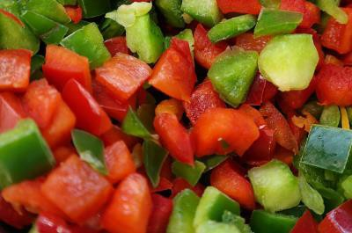
Breaded (covered with bread crumbs and cooked)
Steamed (cooked with water vapor)
Steamed vegetables are not cooked IN the water. They are cooked ABOVE the water.
Sometimes, the food is also described by its appearance:
A thin cut of meat or fish is called a fillet (the “t” in fillet is silent).
Vegetables can be chopped (cut into squares):

Slide 11
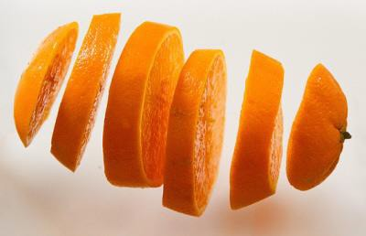
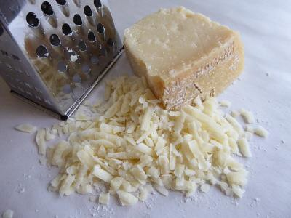
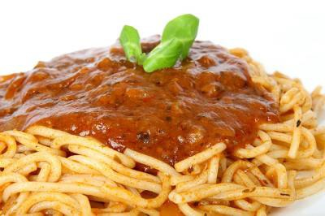
or sliced (cut into thin pieces):
Cheese can be grated (scraped into small pieces):
Also, food can be covered with or topped with a liquid, which is called sauce or dressing.
With meat and pasta, we use the word sauce.
With salads, we use the word dressing:

Slide 12
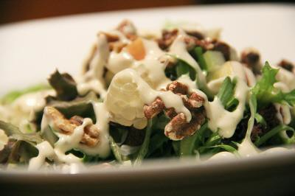

For some more advanced restaurant menu vocabulary, click on these two example menus: American Diner Menu and British Restaurant Menu.
Asking questions about the menu
Here are some typical questions you can ask the server in order to find out more information about the dishes on the menu:
“Is that a big portion?”
(portion = quantity of food)
“Is it spicy?”
(ask this to find out if the food has “hot” peppers)
“Does it have any peanuts in it? I’m allergic.”
(allergic = your body has a bad reaction)
“Do you have any diet / light dishes?”
(some restaurants have a “light” section of the menu, with foods that are healthy and low-fat, but you can also ask the server which dishes are good for a person on a diet)
“Do you have any vegetarian dishes?”
(ask the server this question if you don’t eat meat)

Slide 13
“Does that come with any sides?”
(sometimes, the entrees come with side dishes like potatoes, vegetables, salads, or soups, which are included in the price of the main dish)
“Can I substitute a salad for the soup?” “Can I have a salad instead of the soup?”
(ask one of these questions to find out if it’s possible to exchange one item for
another)
“Do you have a kids’ menu?”
(many servers will give you a kids’ menu automatically if they see you have
children, but you can also request it)
“What are today’s specials?”
(many restaurants have dishes that are prepared especially for that day, and some have a reduced price)
“What do you recommend?”
(if you really don’t know what to order, you can ask the server for a suggestion. Often, he or she will recommend a popular dish that the restaurant is especially known for)
You’ve finished Lesson 8 of the Everyday English Speaking Course! Now take the quiz to test your memory of the phrases from this lesson – and come back tomorrow for part II of our restaurant lesson.

Slide 14
Quiz – Lesson 8
We'd prefer a table the window.
close
near
next
What are today's ?
menus
reserves
specials
Does that with any sides?
go
come
bring
What kind of salad do you have?
coverings
dressings
toppings
I have an 8:00 for a party of four.
appointment
order
reservation
Is that a big ?

Slide 15
plate
portion
special
I can't eat oysters - I'm to shellfish.
allergic
reactive
sick
The lamb chops are in red wine; they're really delicious!
boiled
marinated
steamed
Can I have vegetables the French fries?
instead of
because of
exchange for
The chicken is a low-fat option.
baked
grated
fried
Do you have a kids' ?
appetizer
menu
waiter
I'll be back in a few minutes to take your .
A. combo B. dish C. order

Slide 16
Lesson 8 Quiz - Answers
1.B 2.C 3.B 4.B 5.C 6.B 7.A 8.B 9.A 10.A 11.B 12.C

Slide 17
Session 6- Talking about Movies
Part 2: What would you say in the following
situations? ( More Idioms & collocations)
https://befluent.me/

Slide 18
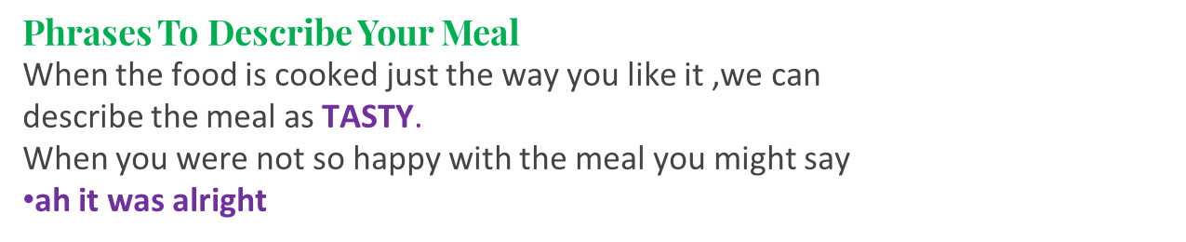
Session 7- Talking about Food
Questions About Eating Out
Okay, so when, when we’re talking about eating out, that might be to do with places that are local. If you’re sharing offices with these people, and you’ve just joined them, you might want to know the places to eat locally for lunch, or perhaps for an early dinner. So you could ask questions like,
How often do you eat out?
Have you tried any new restaurants recently?
Or
What are the restaurants like around here?
Are there any nice small cafes? What are the prices like?
Are they good for lunches/dinners?
You could also ask,
Do you like fast food?
Obviously, people eat it, particularly if they’re in a hurry.
What type of fast food do you like?
What fast-food restaurants are available here?
Do you order food as a takeaway?
Have you tried some of those food delivery apps?
https://befluent.me/

Slide 19
Session 6- Talking about Movies
Part 3: Speaking Practice
https://befluent.me/

Slide 20
Session 7- Talking about Food
What’s your favorite dish?
What’s your favorite meal?
Are there any foods that you absolutely hate? Or Are there any foods that you absolutely won’t eat?
Do you like trying new foods?
What’s the most recent food that you’ve tasted?
Have tried Japanese food?
Do you like fast food?
What type of fast food do you like?
What fast-food restaurants are available here?
Do you order food as a takeaway?
Have you tried some of those food delivery apps?
12. A lot of people like to cook. Do you like cooking? Are you a good cook?
https://befluent.me/

Slide 21
Session 7- Talking about Food
13. What’s your favorite dish to prepare?
14. What’s your cooking specialty? Or What’s the key dish that you prepare that everybody talks about?
So what are you (well-)known for?
15. Which do you prefer eating out or eating at home?
16. Do you usually skip breakfast?
Or
Do you bring breakfast with you and have it in the office?
17. I’m sick of sandwiches. Do you have any really good suggestions for lunches that you can prepare easily?
https://befluent.me/

Slide 22
Session 7- Talking about Food
18. What do you usually have for dinner?
19. Do you prepare dinner the day before? If so, do you prepare dinner as we do enough for two/three days?
20. Do you ever go on diets? If so, do you follow a special type of diet?
21. Are there foods you definitely leave out/include to make sure it’s a healthy diet?
22. Do you think diets are useful or not? Are they just fads? (fad= something that’s here today gone tomorrow.)
https://befluent.me/

Slide 23
Session 7- Talking about Food
Thank you!☺
https://befluent.me/

